Slide 1
2023-03-22

Slide 2
10.2.2: Merge Sort

Slide 3
Review: Previous Sort Methods
Selection Sort: Insertion Sort:

Slide 4
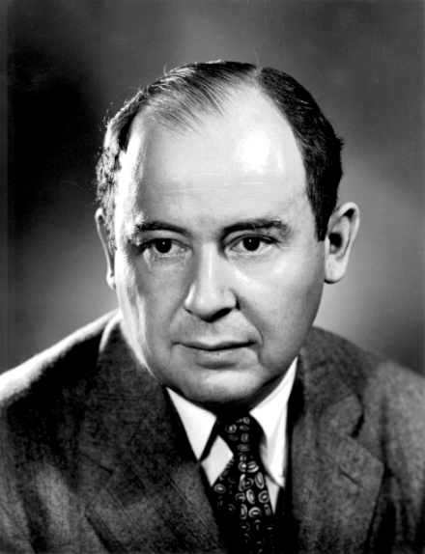
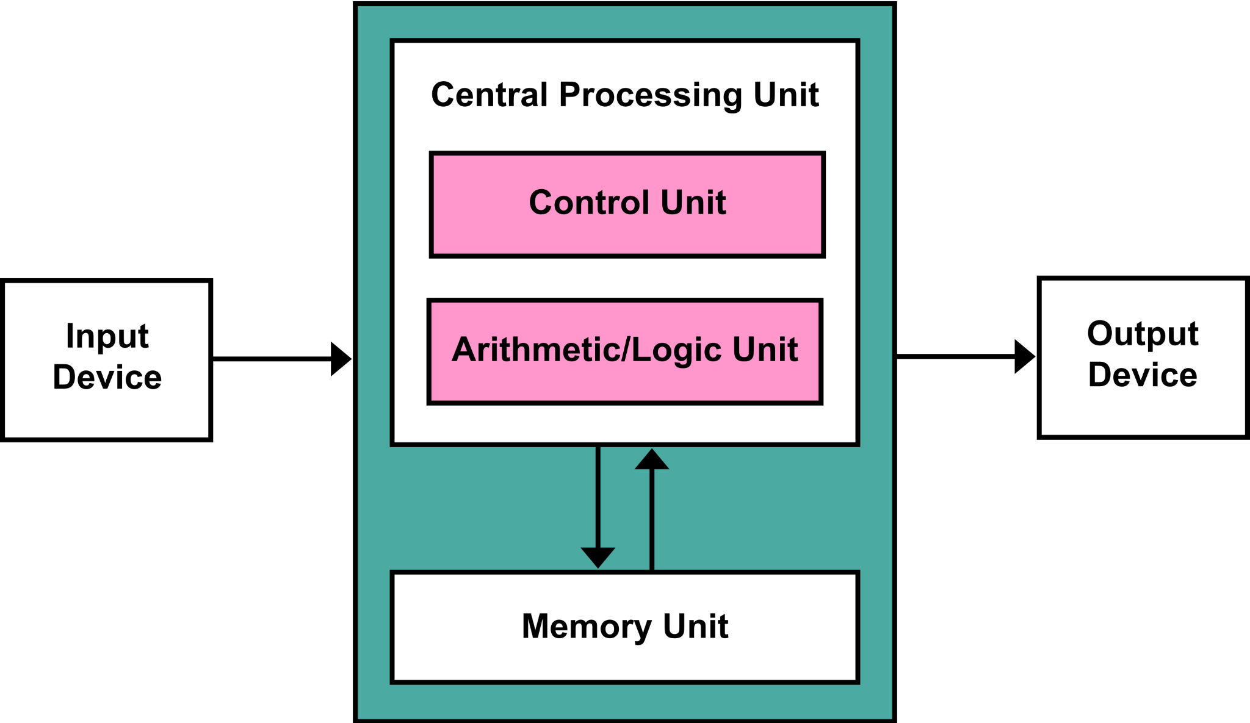
Merge Sort
Merge Sort is a divide and conquer sorting algorithm, much like Binary Search is a divide and conquer search algorithm.
Merge Sort divides the input array in half, and recursively Merge Sorts the halves.
This algorithm was invented in 1945 (!) by John Von Neumann (1903-1957), a genius mathematician and early computer scientist.
Among other things, Von Neumann invented the Von Neumann Architecture, which is still the conceptual model for how a computer works.

Slide 5
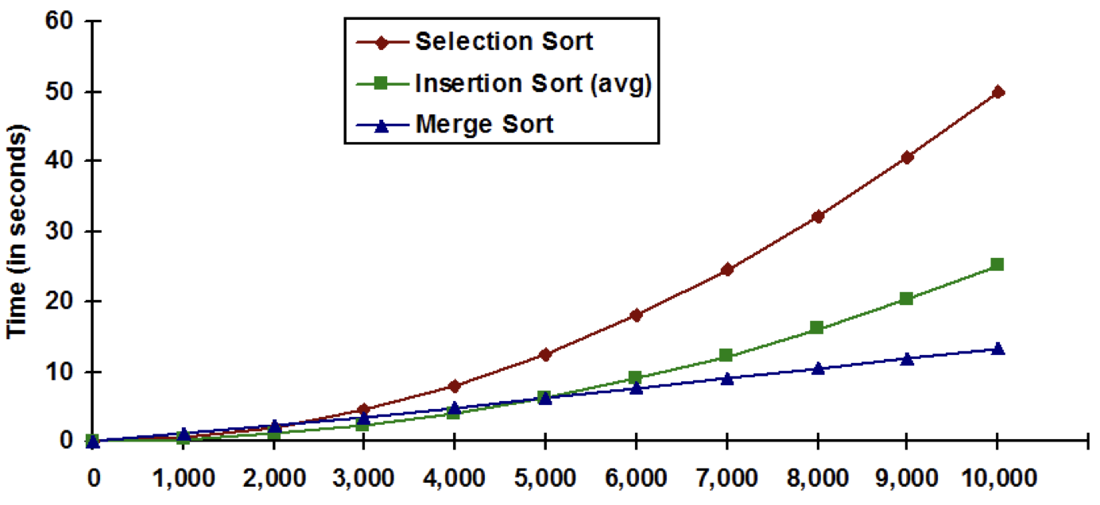
Sorting Algorithm Efficiency
Merge sort worst case performance is O(n log n)

Slide 6
Ω(N log N)
A lower bound for a problem is the worst-case running time of the best possible algorithm for that problem.
"Big Omega" (Ω) is used to designate a lower bound.
A proof exists that the lower bound for comparison-based sorting is Ω(N log N).
That means that no algorithm, however smart, could possibly be faster, in the worst-case, then N log N comparisons.

Slide 7
Merge Sort: an O(N log N) sort
Merge Sort has O(N log N) running time for best case, worst case, and average case.
This means that Merge Sort is an efficient sorting algorithm. In the worst case, it's proven that one can't conceive a sorting algorithm that does less comparisons!
There are other factors in how well a sorting algorithm performs though: How much additional memory it needs, how well it uses computer cache memory, how it performs on different kinds of input data (randomly ordered, partially ordered, etc.)
Another popular divide and conquer sorting algorithm is Quicksort (1951), which is faster than Merge Sort in some situations and slower in others.

Slide 8
Merge Sort: O(N) Space Complexity
Merge Sort, as it is typically implemented, requires temporary space.
To do its merges, it needs an extra array the same size as the source.
There are ways to reduce the space overhead, but they come with trade-offs, such as making the algorithm more complex or increasing the amount of data copied.
It can actually be reduced to O(1) using linked lists, which we saw on Monday!

Slide 9
Merge Sort: Copying Data
There's copying of data between the main array and the temporary array.
This can be minimized, but at the cost of making the algorithm more complicated.
The code given in CS Awesome just copies the data a lot... that is fine and that's what we'll work through, for simplicity.
The Wikipedia article gives fancier code that avoids the copying.

Slide 10
Merge Sort: A Stable Sort
A sort algorithm is said to be stable if it always gives the same results.
When would a sort algorithm ever not give the same result??
When there are duplicate keys, multiple sorted orderings of the same input are possible.
Why is a stable sort important? Sometimes, it's not. But the boss at a big company may not like it if you run the same report twice and get ever-so-slightly different results!
Name (key) | Score
Jill Student | 100
Joe Student | 96
Joe Student | 95
Name (key) | Score
Jill Student | 100
Joe Student | 95
Joe Student | 96

Slide 11
Merge Sort: Split the array into halves down to one element
38
27
43
3
9
82
10
38
27
43
3
9
82
10
38
27
43
3
9
82
10
38
27
43
3
9
82
10

Slide 12
Merge Sort: Sort the halves and merge them together
38
27
43
3
9
82
10
27
38
3
43
9
82
10
3
27
38
43
9
10
82
3
9
10
27
38
43
82

Slide 13
Merge Sort Pseudocode
If the list’s size is 0 or 1, just return the original list (as it is sorted)
Split the list parameter int two lists of roughly equal size
Recursively Merge Sort both split lists, list 1 and list 2
Merge the two sorted lists and return the result

Slide 14
Merge Sort "Lists"
Conceptually, you can think of Merge Sort as splitting the input into a bunch of smaller sub-lists, and recursively merging all the sub-lists together.
In practice, we don't want to create tons of lists! We want to allocate as little memory as possible, and copy as little data as possible. So we want to work as much as possible in the array being sorted.
This means that a "sub-list" is really a "view" into the original array, tracked with two indices, begin and end.
Because of Merge Sort's merge operation, we do need some temporary storage, but that comes out to one additional temporary array that is the same size as the array being sorted.

Slide 15
Merge Sort: The Merge
Array A
3
27
38
43
9
10
82
i
j
Array B
3
9
10
27
38
43
82
k (at start)
k (when done)
i = current index in left half, j = current index in right half. k = index in output array.
While i <= ending index of left half and j <= ending index of right half: B[k++] = smaller of A[i] and A[j]. Advance i if we used A[i], or advance j if we used A[j].
After, one of the halves may still have something left... output anything left over into B.

Slide 16
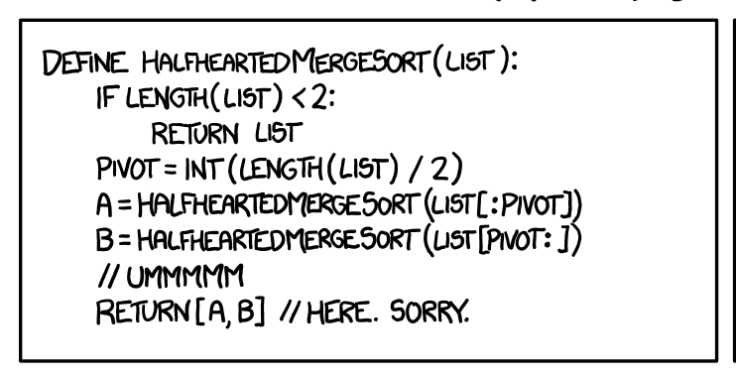
Show me the code!
https://xkcd.com/1185/

Slide 17
CSAwesome's Merge Sort (edited for brevity) [1/2]
public static void mergeSort(int[] elements) {
int n = elements.length;
int[] temp = new int[n];
mergeSortHelper(elements, 0, n - 1, temp);
}
private static void mergeSortHelper(int[] elements,
int from, int to, int[] temp) {
if (from < to) {
int middle = (from + to) / 2;
mergeSortHelper(elements, from, middle, temp);
mergeSortHelper(elements, middle + 1, to, temp);
merge(elements, from, middle, to, temp);
}
}

Slide 18
CSAwesome's Merge Sort implementation [2/2]
private static void merge(int[] elements, int from, int mid, int to, int[] temp) {
int i = from, j = mid + 1, k = from;
while (i <= mid && j <= to) {
if (elements[i] < elements[j]) {
temp[k++] = elements[i++];
} else {
temp[k++] = elements[j++];
}
}
while (i <= mid) {
temp[k++] = elements[i++];
}
while (j <= to) {
temp[k++] = elements[j++];
}
for (k = from; k <= to; k++) {
elements[k] = temp[k];
}
}
Here, we're comparing the current elements from each half, and taking the smaller one. We only advance the pointer for the side we took from!
If we got here, one or both halves are done. Output anything left over from the left half.
Output anything left over from the right half. (Only one of these loops will run.)
Copy everything back from the temp array. (This can be avoided with some extra fanciness.)

Slide 19
CSAwesome's Merge Sort implementation [2/2]
private static void merge(int[] elements, int from, int mid, int to, int[] temp) {
int i = from, j = mid + 1, k = from;
while (i <= mid && j <= to) {
if (elements[i] < elements[j]) {
temp[k++] = elements[i++];
} else {
temp[k++] = elements[j++];
}
}
while (i <= mid) {
temp[k++] = elements[i++];
}
while (j <= to) {
temp[k++] = elements[j++];
}
for (k = from; k <= to; k++) {
elements[k] = temp[k];
}
}
Here, we're comparing the current elements from each half, and taking the smaller one. We only advance the pointer for the side we took from!
If we got here, one or both halves are done. Output anything left over from the left half.
Output anything left over from the right half. (Only one of these loops will run.)
Copy everything back from the temp array. (This can be avoided with some extra fanciness.)

Slide 20
CSAwesome's Merge Sort implementation [2/2]
private static void merge(int[] elements, int from, int mid, int to, int[] temp) {
int i = from, j = mid + 1, k = from;
while (i <= mid && j <= to) {
if (elements[i] < elements[j]) {
temp[k++] = elements[i++];
} else {
temp[k++] = elements[j++];
}
}
while (i <= mid) {
temp[k++] = elements[i++];
}
while (j <= to) {
temp[k++] = elements[j++];
}
for (k = from; k <= to; k++) {
elements[k] = temp[k];
}
}
Here, we're comparing the current elements from each half, and taking the smaller one. We only advance the pointer for the side we took from!
If we got here, one or both halves are done. Output anything left over from the left half.
Output anything left over from the right half. (Only one of these loops will run.)
Copy everything back from the temp array. (This can be avoided with some extra fanciness.)

Slide 21
CSAwesome's Merge Sort implementation [2/2]
private static void merge(int[] elements, int from, int mid, int to, int[] temp) {
int i = from, j = mid + 1, k = from;
while (i <= mid && j <= to) {
if (elements[i] < elements[j]) {
temp[k++] = elements[i++];
} else {
temp[k++] = elements[j++];
}
}
while (i <= mid) {
temp[k++] = elements[i++];
}
while (j <= to) {
temp[k++] = elements[j++];
}
for (k = from; k <= to; k++) {
elements[k] = temp[k];
}
}
Here, we're comparing the current elements from each half, and taking the smaller one. We only advance the pointer for the side we took from!
If we got here, one or both halves are done. Output anything left over from the left half.
Output anything left over from the right half. (Only one of these loops will run.)
Copy everything back from the temp array. (This can be avoided with some extra fanciness.)

Slide 22
CSAwesome's Merge Sort implementation [2/2]
private static void merge(int[] elements, int from, int mid, int to, int[] temp) {
int i = from, j = mid + 1, k = from;
while (i <= mid && j <= to) {
if (elements[i] < elements[j]) {
temp[k++] = elements[i++];
} else {
temp[k++] = elements[j++];
}
}
while (i <= mid) {
temp[k++] = elements[i++];
}
while (j <= to) {
temp[k++] = elements[j++];
}
for (k = from; k <= to; k++) {
elements[k] = temp[k];
}
}
Here, we're comparing the current elements from each half, and taking the smaller one. We only advance the pointer for the side we took from!
If we got here, one or both halves are done. Output anything left over from the left half.
Output anything left over from the right half. (Only one of these loops will run.)
Copy everything back from the temp array. (This can be avoided with some extra fanciness.)

Slide 23
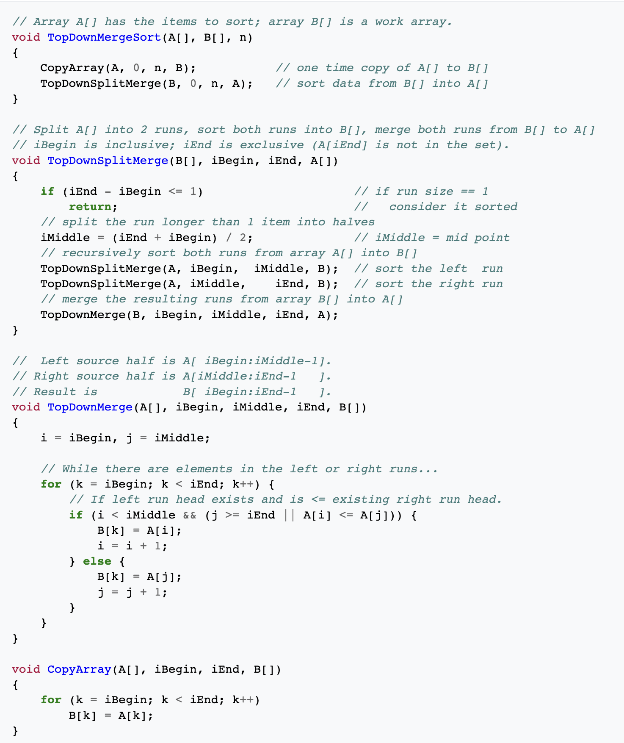
Avoiding the copying
Here's the extra fanciness...
This is the implementation in the Wikipedia article for Merge Sort.
It avoids the copying of data that the CS Awesome algorithm does, by alternately merging into array A or array B.
It does do a one-time copy at the beginning of the sort.

Slide 24
Your turn!
Go through the exercises for chapter 10.2.2 Merge Sort in CSAwesome
Other than that, one of the best exercises is to work through a merge sort on paper. Just like we did on the whiteboard, make an array of ~10 elements and merge sort it yourself.

